Slide 1

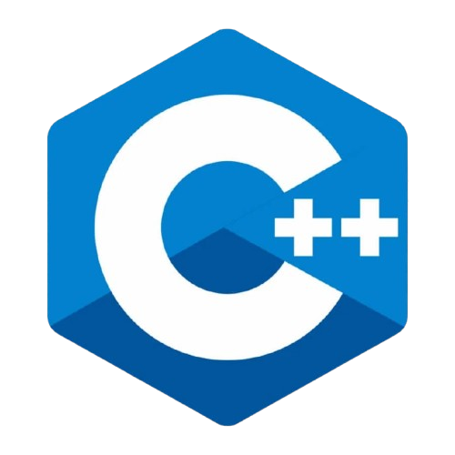
By Parthasarathi Swain

Slide 2

What is an Operator?
An operator is a symbol that performs an operation on variables and values.
Types of Operators:
1.Arithmetic Operators
Perform basic math operations
+, -, *, /, %
Example: a + b, x * y
2.Assignment Operators
Assign values to variables
=, +=, -=, *=, /=, %=
Example: a = 5, b += 2
3.Relational (Comparison) Operators
Compare two values
==, !=, >, <, >=, <=
Example: a == b, x < y
4.Logical Operators
Combine or invert logical values
&& (AND), || (OR), ! (NOT)
Example: a > 0 && b < 10
5.Increment/Decrement Operators
Increase or decrease value by 1
++, -- (prefix/postfix)
Example: ++x, y--
6.Bitwise Operators
Operate on bits
&, |, ^, ~, <<, >>
Example: a & b, x << 2
7.Conditional (Ternary) Operator
Short form of if-else
? :
Example: max = (a > b) ? a : b;
8.Sizeof Operator
Returns size of a data type or variable
Example: sizeof(int), sizeof(arr)
www.opentechz.com

Slide 3
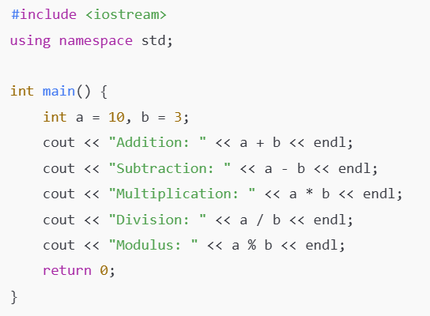
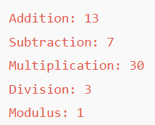
Example 1 : Arithmetic Operators
www.opentechz.com
www.opentechz.com

Slide 4
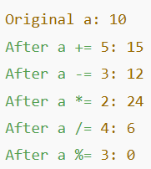
Example 2 : Assignment Operators
#include <iostream>
using namespace std;
int main() {
int a = 10;
cout << "Original a: " << a << endl;
a += 5;
cout << "After a += 5: " << a << endl;
a -= 3;
cout << "After a -= 3: " << a << endl;
a *= 2;
cout << "After a *= 2: " << a << endl;
a /= 4;
cout << "After a /= 4: " << a << endl;
a %= 3;
cout << "After a %= 3: " << a << endl;
return 0;
}
www.opentechz.com
www.opentechz.com

Slide 5
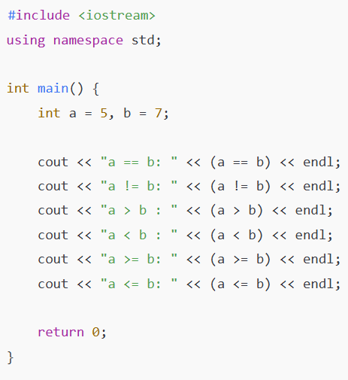
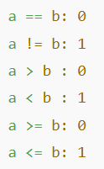
Example 3 : Relational Operators
www.opentechz.com
www.opentechz.com

Slide 6
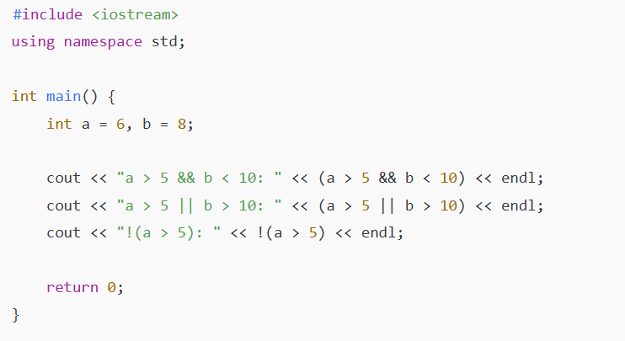
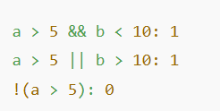
Example 4 : Relational Operators
www.opentechz.com
www.opentechz.com

Slide 7
Example 5 : Increment and Decrement Operators
#include <iostream>
using namespace std;
int main() {
int a = 5;
cout << "Post-increment a++: " << a++ << endl; // prints 5, then a becomes 6
cout << "After post-increment, a: " << a << endl;
cout << "Pre-increment ++a: " << ++a << endl; // a becomes 7, then prints 7
cout << "Post-decrement a--: " << a-- << endl; // prints 7, then a becomes 6
cout << "Pre-decrement --a: " << --a << endl; // a becomes 5, then prints 5
return 0;
}
1. Prefix (e.g., ++x or --x)
First changes the value, then uses it.
2. Postfix (e.g., x++ or x--)
First uses the current value, then changes it.
www.opentechz.com
www.opentechz.com

Slide 8

Thank You
www.opentechz.com

